Slide 1
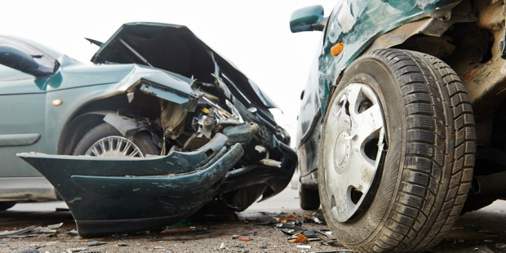
PRESENTATION
Development of a wireless sensor system for the vehicles to resolve different problems.
Presented by :
Apoorva (T.Leader)
Gaurav
Mayank
Neeraj

Slide 2
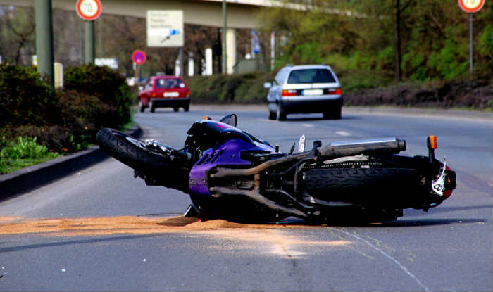
PROBLEM STATEMENT
We need to have a wireless sensor system for safety measures because nowadays, the rate of car theft and accidents caused due to driving by underage teenagers and by non-licensed person is increasing frequently.

Slide 3
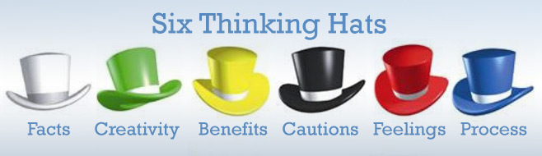


Six Thinking Hats
Blue Hat:- To resolve the problem of the theft of the vehicles and control over the without licensed driving.
White Hat:-
According to Times of India , in Delhi a vehicle is stolen in every 13 minutes.
According to Hindustan Times , the average age of all the traffic violators is 11 years.
According to India Today, 1.62 lakhs road accidents were caused by under age drivers and those without licenses in the year gap of 2012 to 2014.

Slide 4


Green Hat :-
Building a wireless sensor system which connected with mobile number to get the information about the driver.
Building a central server which connected with internet to connect with the sensor of the vehicles using their driver license.
Yellow Hat :-
It is an anti-theft program in the field of vehicles.
Their will be a decrement in the rate of car/vehicles accidents.

Slide 5


Black hat :-
It is a complex problem to build such a program.
It is very difficult to implement such technology in all the vehicles.
POLITICAL ISSUE: political parties are not going to help it out in its implementation as it affects their vote bank.
Red hat :-
No one will be capable to operate his or her vehicle without license in case of any emergency.
It will be a biggest challenge as the teenage section of our society is not going to accept it easily.

Slide 6


Creative Solution
Building a wireless sensor system which connected with the license of the driver. After the scanning of that license the owner will get a message on their cellphone about the details of the driver.
Building a central server which connected with internet to connect with the sensor of the vehicles using their driver license so that the details of the driver will save on the server which will be available later.

Slide 7
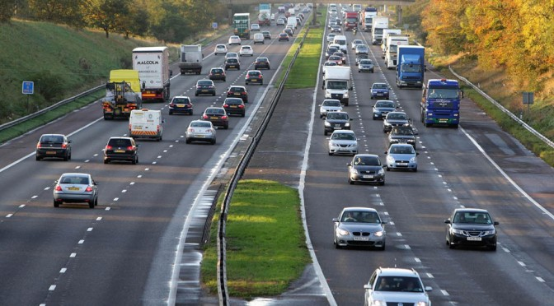
Impact
Reduction of the theft of vehicles.
Reduction in the rate of accidents occurring
to underage driving.
Better traffic management.

Slide 8




Competition
Use of sensor chips in keys to lock or unlock the car without which it is very difficult to switch on the engine of the car.

Slide 9
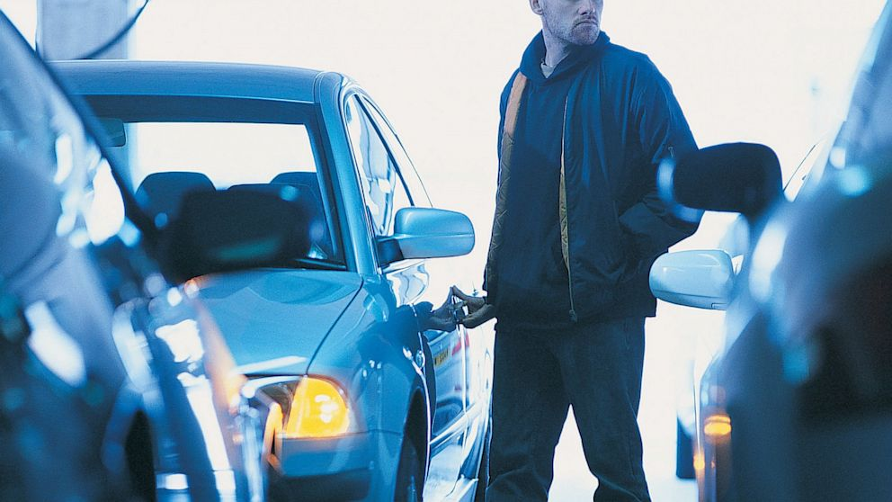
Help needed for the execution of the idea…
Financial help :- need a systematic lab for the testing of the equipment's as equipment related to information technology are very costly .
2. Marketing help :- support from different motor companies for the execution of the idea
3. Strategic help :- need a lot of technical support for the testing and implementation of the idea.

Slide 10
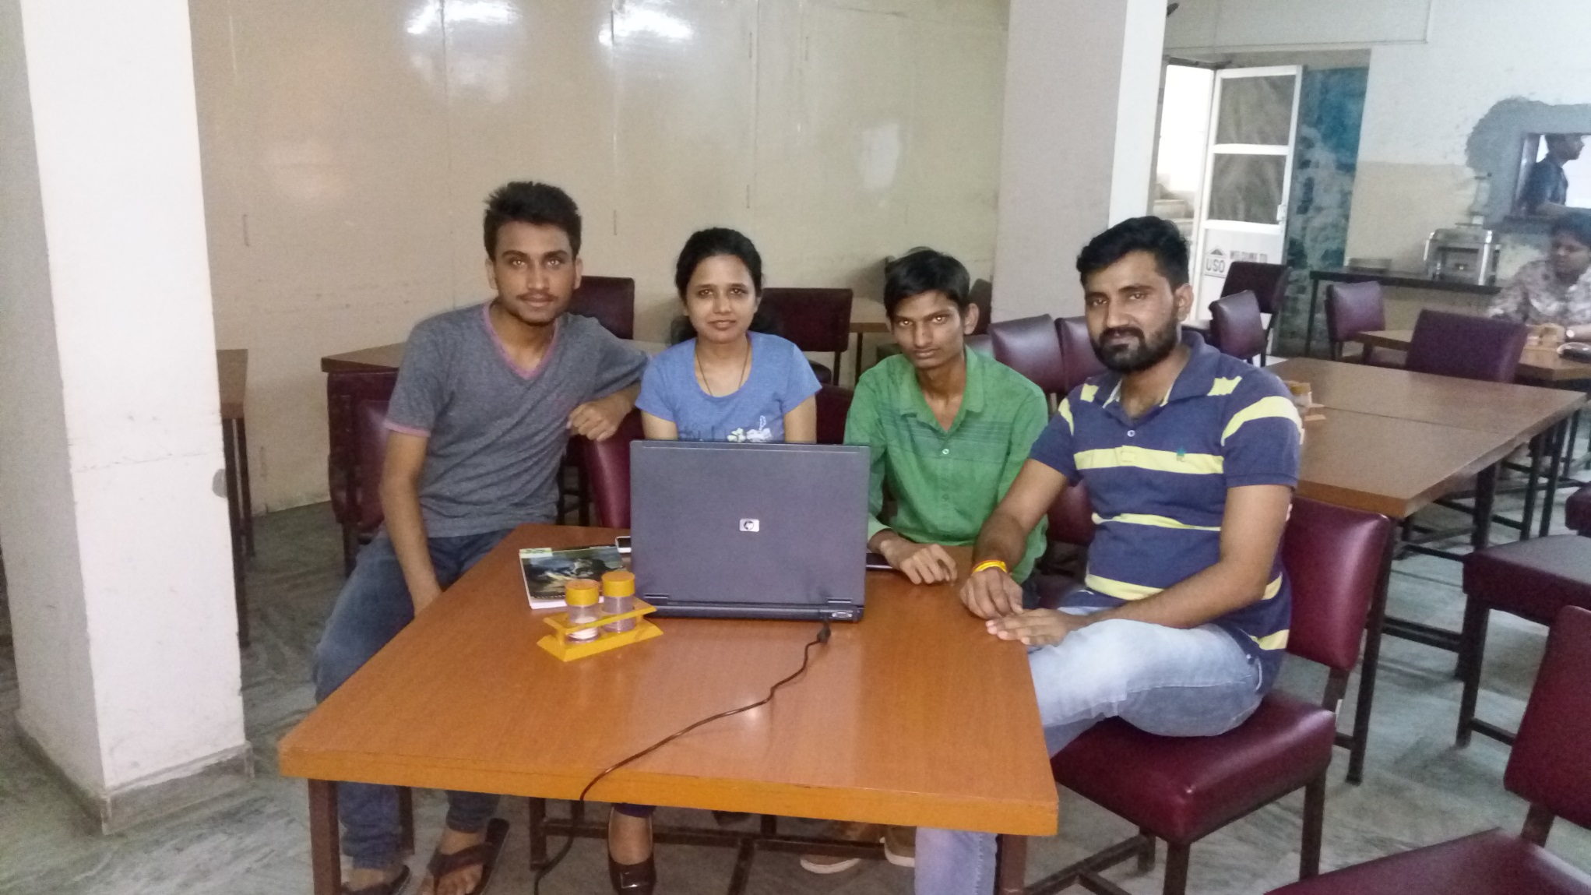
THANK YOU

